Slide 1
DIRT RANGERS

Slide 2

HUSTLE! STRENGTH! PERSEVERANCE!

Slide 3

1. ABOUT US

Slide 4
Oldest motorsports team of SRM-IST NCR campus
We compete in Off-road motorsport events, conducted all over India
With Six years of working experience, and an extremely hard working and dedicated team, we aim to bring glory to our Institute

Slide 5
2. PAST ACHIEVEMENTS

Slide 6
Competing in QBDC 2016
Competing in MEGA ATV 2016
Clearing SAE BAJA VIRTUALS 2018
Clearing dynamic and static events of SAE BAJA 2018(in first attempt)
Competing in SAE BAJA 2019
Competing in ESI 2019
Competing in MEGA ATV 2019

Slide 7
3. FUTURE PLANS

Slide 8
We are participating in SAE BAJA 2020, Pithampur, which happens to be an International Event
We are planning to participate in MEGA ATV 2020, GOA, which happens to be a National Event
We are planning to participate in ESI 2020,PUNE, which happens to be a National Event

Slide 9
4. PROJECT TECHNICAL DETAILS

Slide 10
Particulars | Proposed
Overall Length | 72 Inches
Overall Width | 60.5Inches(F) 60Inches(R)
Ground Clearance | 11Inches(F) 10Inches(R)
Wheelbase | 57Inches
Track Width | 53Inches(F) 50Inches(R)
Roll Cage Material | AISI 4130-Carbon Steel
Overall Weight | 240kg
Engine | Briggs & Stratton 305 cc 10HP
Transmission | Custom single speed reduction gear box with CVT
Tires | 25x7-10(F) 25x7-10(R)
Maximum Speed ( Kmph ) | 56.73 KMPH
Maximum Acceleration | 1 m/s²
Grad ability % | 41 Degree
Stopping Distance | 4.25Meters
Kerb Weight | 140Kg

Slide 11
5. INNOVATION DETAILS

Slide 12

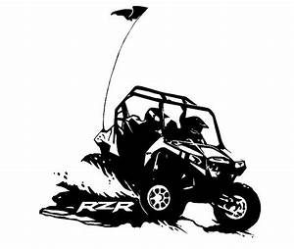
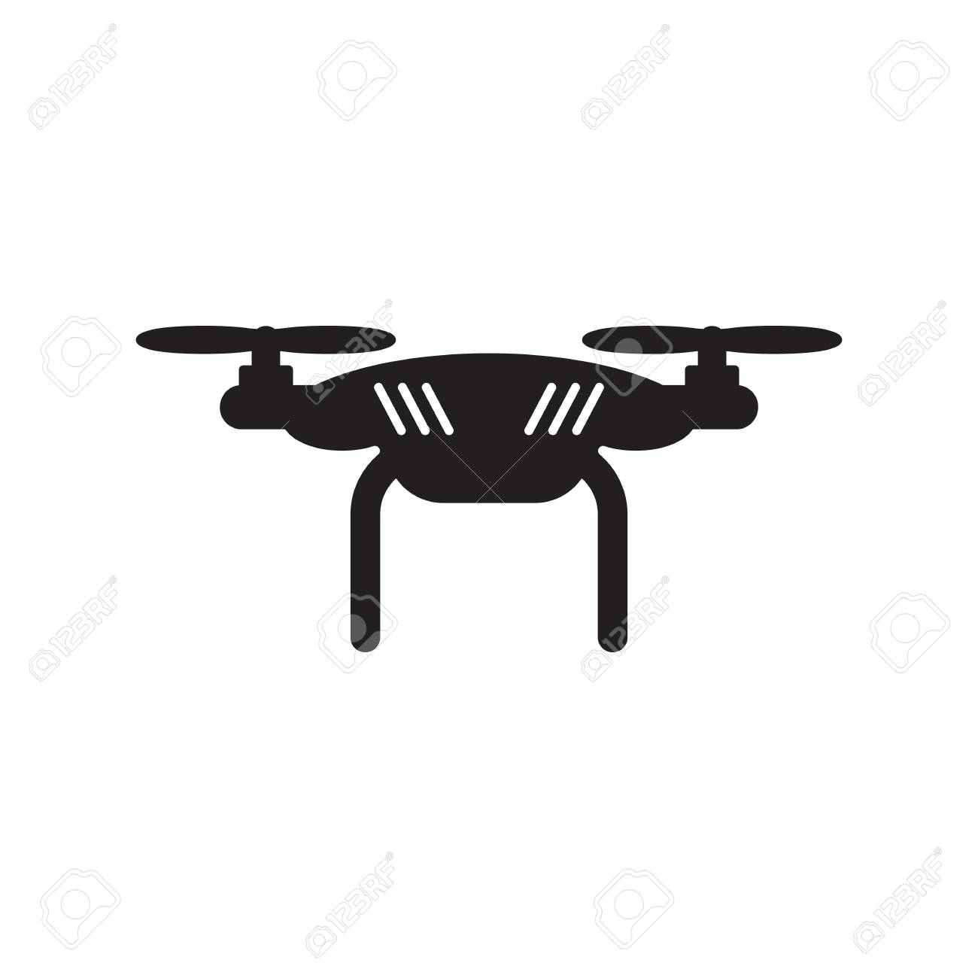
DRONE MONITORING
An automated drone will constantly follow the vehicle, thus enabling better co-ordination between crew members and driver.

Slide 13


Details
Arms with slider joints
Piezoelectric Fuel Measuring Tank
Constant monitoring of vehicle using induced transponders
Drone monitored vehicle movement assisted with extra lighting on track

Slide 14
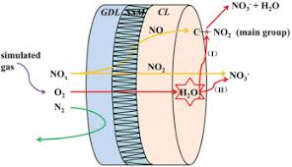
Electrochemical Exhaust Gas Purification

Slide 15
DETAILS
This text is divided into two parts; the first part gives a short recapitulation of the development status of the electrochemical reactor for soot removal, while the second part gives a description of activities on electrochemical NO_{x} reduction. An electrochemical cell consisting of three metallic electrodes on solid-state electrolyte yttria-stabilized zirconia (YSZ) operating under electric polarization between a gold working electrode and a platinum counter electrode allows selective NO₂ detection at 400-550 °C with high sensitivity, and without any significant interferences to other gases like hydrocarbons, carbon monoxide and also ammonia and nitrogen monoxide. A mechanism based on cathodic overpotential is proposed.

Slide 16
6. BUDGET DETAILS

Slide 17
Expected Expenditure on Manufacturing

Slide 18
7. PROJECT SCHEDULE

Slide 19
June 2019
Rule Book Study
Rectangle of Max. Dimensions
Driver Dimensions
July 2019
Design of roll cage
PVC Modeling
Related calculations
August and September,2019
October and November 2019
December 2019
January 2020

Slide 20
8. TEAM MEMBERS’ DETAILS

Slide 21
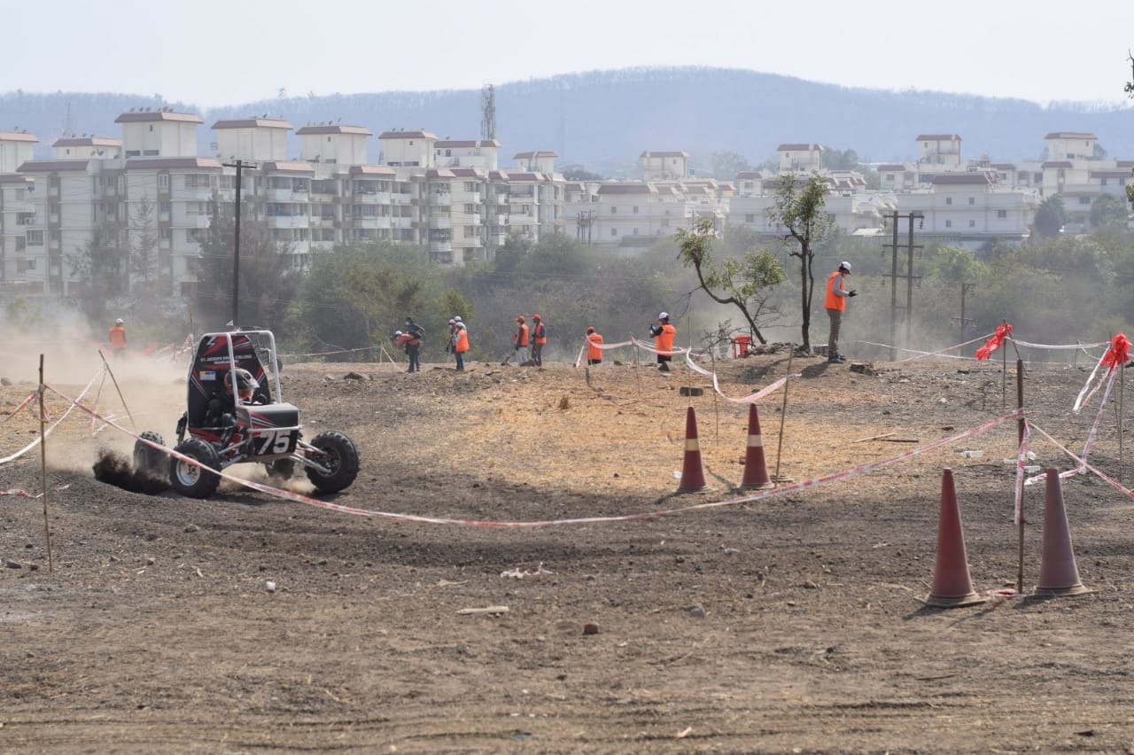

Slide 22
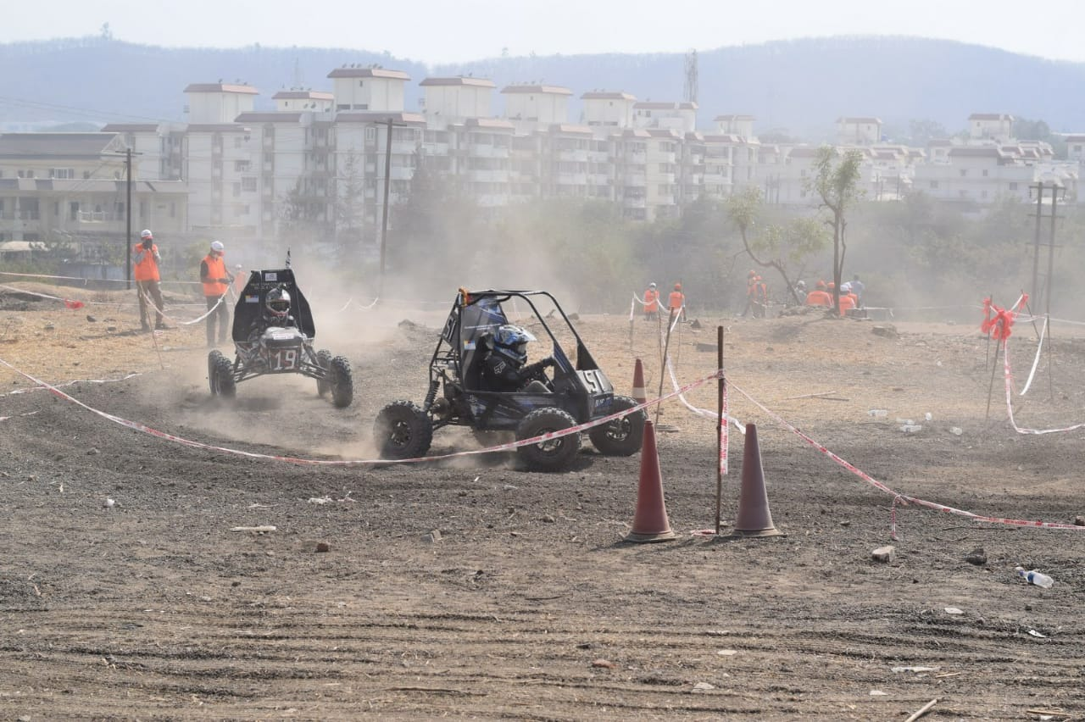

Slide 23
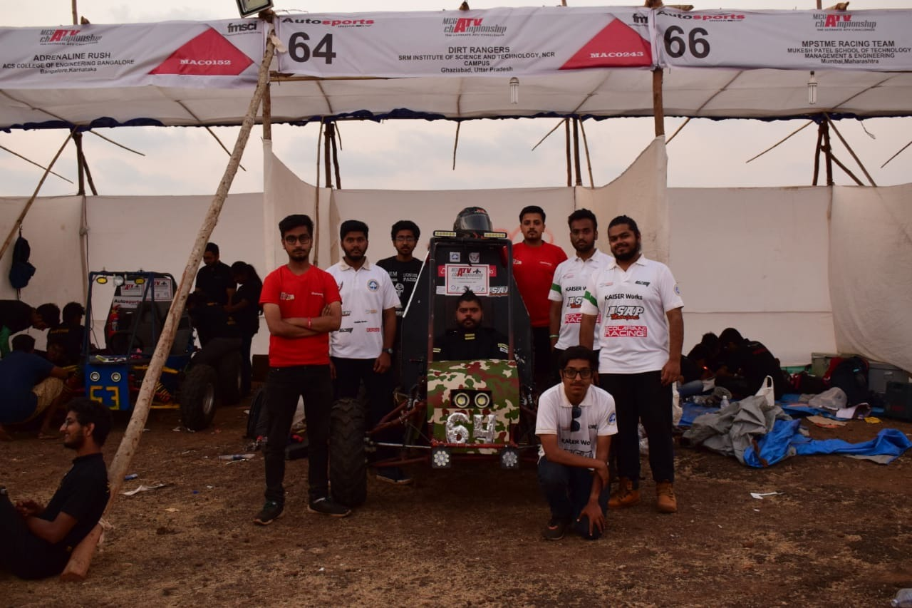

Slide 24
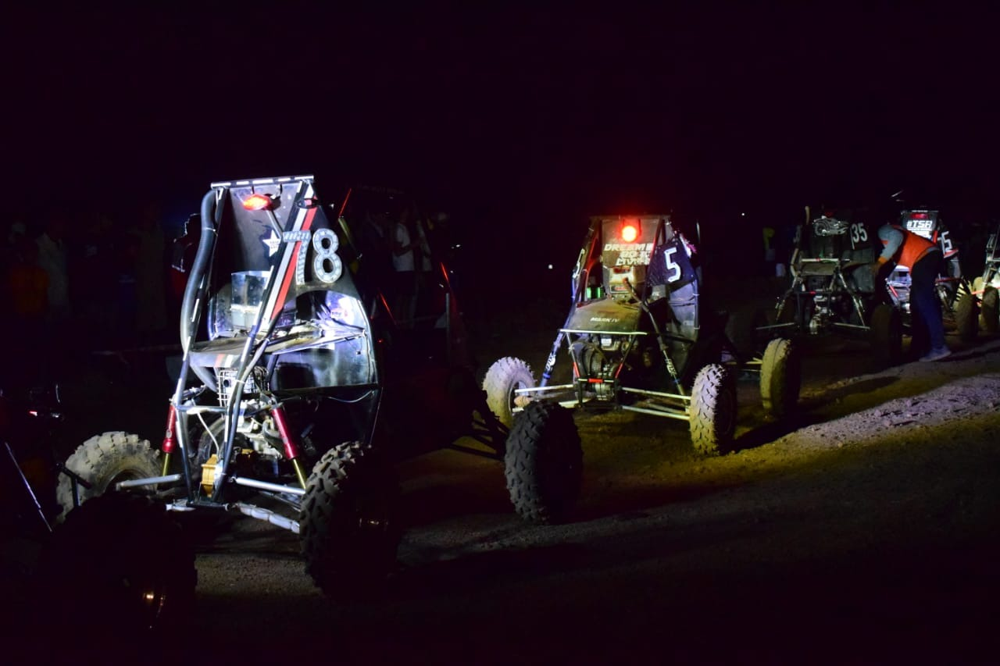

Slide 25

Quotations are commonly printed as a means of inspiration and to invoke philosophical thoughts from the reader.

Slide 26

THANKYOU!

Slide 27

CREDITS
Special thanks to all the people who made and released these awesome resources for free:
Presentation template by SlidesCarnival
Photographs by Unsplash

Slide 28

PRESENTATION DESIGN
This presentation uses the following typographies and colors:
Titles: Barlow Bold
Body copy: Barlow Normal
You can download the fonts on this page:
https://www.fontsquirrel.com/fonts/barlow
Yolk yellow #ffb000 · Dark gray #434343
You don’t need to keep this slide in your presentation. It’s only here to serve you as a design guide if you need to create new slides or download the fonts to edit the presentation in PowerPoint®

Slide 29
SlidesCarnival icons are editable shapes.
This means that you can:
Resize them without losing quality.
Change fill color and opacity.
Change line color, width and style.
Isn’t that nice? :)
Examples:

Slide 30
Now you can use any emoji as an icon!
And of course it resizes without losing quality and you can change the color.
How? Follow Google instructions https://twitter.com/googledocs/status/730087240156643328
😉
✋👆👉👍👤👦👧👨👩👪💃🏃💑❤😂😉😋😒😭👶😸🐟🍒🍔💣📌📖🔨🎃🎈🎨🏈🏰🌏🔌🔑 and many more...

